Slide 1
HTML Forms and Server-Side Data
By Jinzhu Gao

Slide 2
Objectives
Learn how to create forms for storing and retrieving info from web servers
Learn how to write server-side code that processes info sent by a form

Slide 3
Web Data
Most interesting web pages revolve around data
examples: Google, IMDB, Digg, Facebook, YouTube, Rotten Tomatoes
can take many formats: text, HTML, XML, multimedia
Many of them allow us to access their data
Some even allow us to submit our own new data
Most server-side web programs accept parameters that guide their execution

Slide 4
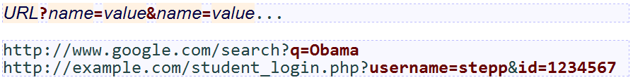
Form Basics
Parameterized Pages and Query strings
query string:
A set of parameters passed from a browser to a web server
Often placed at the end of a URL
PHP code on the server can examine and utilize the value of parameters
A way for PHP code to produce different output based on values passed by the user

Slide 5
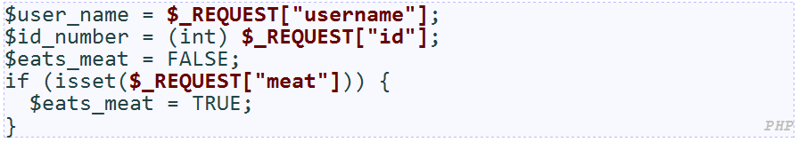
Form Basics
Parameterized Pages and Query strings
query string:
A set of parameters passed from a browser to a web server
Often placed at the end of a URL
A way for PHP code to produce different output based on values passed by the user

Slide 6
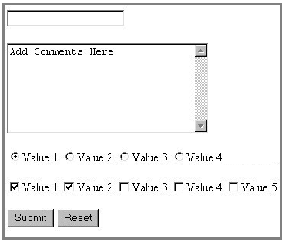
Form Basics
HTML form:
A group of UI controls that accepts information (via query string) from the user and sends the information to a web server.
Controls: Buttons, checkboxes, and text fields
JavaScript can be used to create interactive controls (seen later)

Slide 7
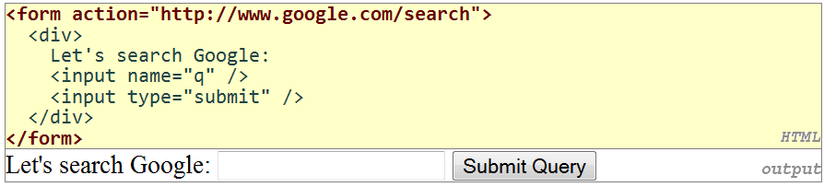
Form Basics
HTML form:
required action attribute gives the URL of the page that will process this form's data
when form has been filled out and submitted, its data will be sent to the action's URL
one page may contain many forms if so desired
must wrap the form's controls in a block element such as div

Slide 8
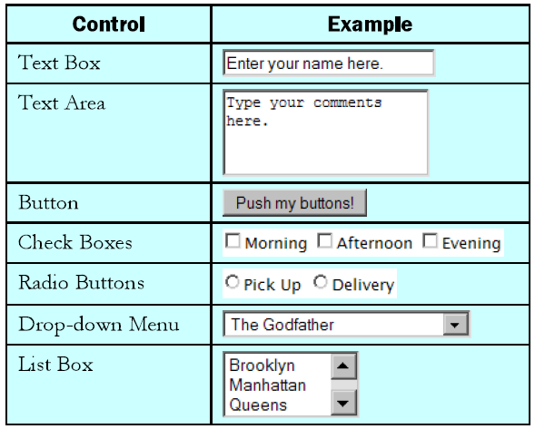
Form Controls

Slide 9
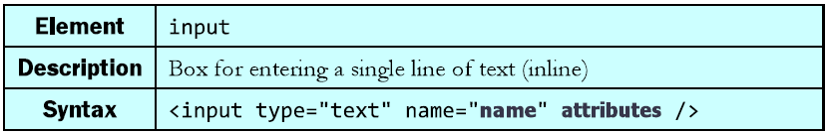
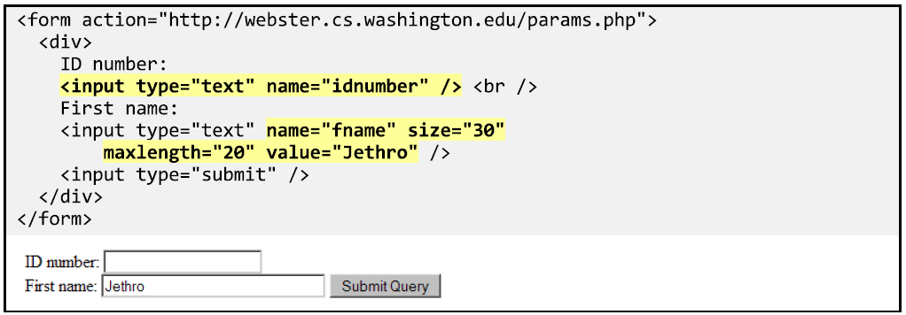
Text Boxes
Notes:
type can be button, checkbox, file, hidden, password, radio, reset, submit, text, ...
input attributes: disabled, maxlength, readonly, size, value

Slide 10
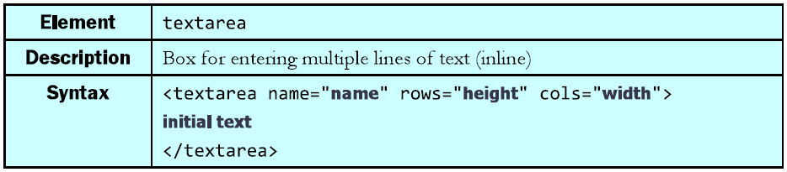
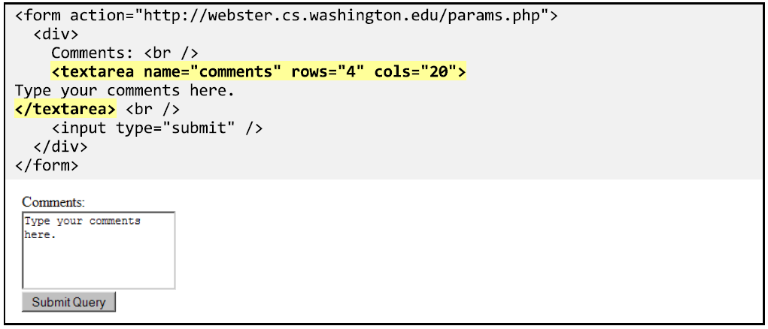
Text Areas

Slide 11
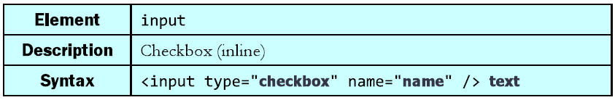
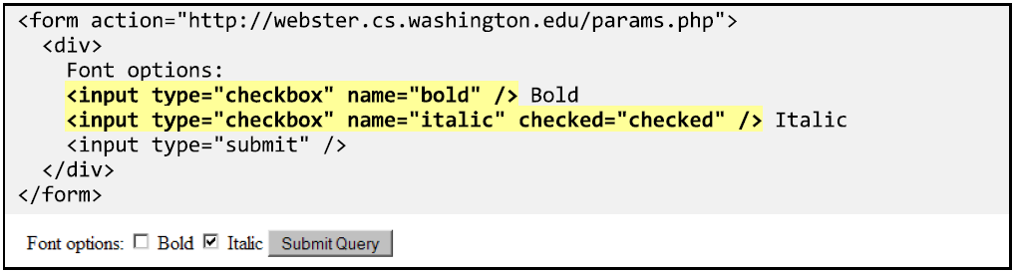
Checkboxes

Slide 12
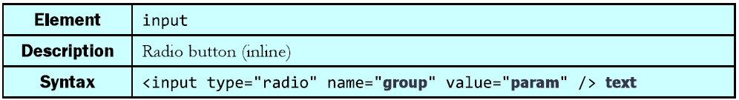
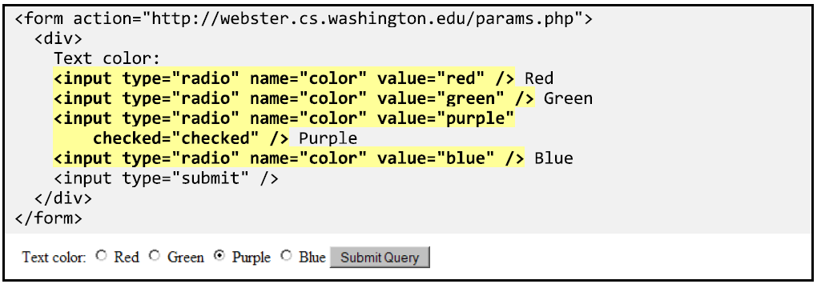
Radio Buttons

Slide 13
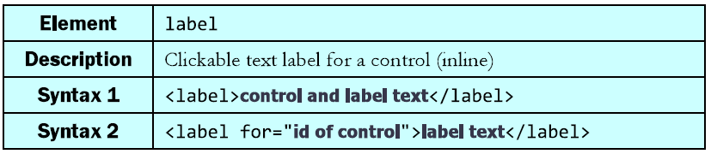
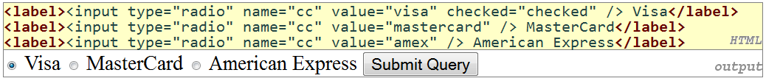
Text Labels
associates nearby text with control, so you can click text to activate control
can be used with checkboxes or radio buttons
label element can be targeted by CSS style rules

Slide 14
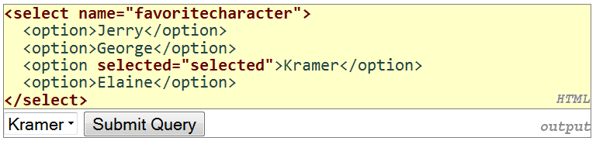
Drop-down List
Notes:
option element represents each choice
select optional attributes: disabled, multiple, size
optional selected attribute sets which one is initially chosen

Slide 15
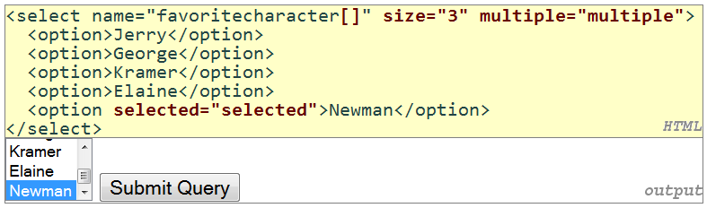
Drop-down List
Notes:
optional multiple attribute allows selecting multiple items with shift- or ctrl-click
must declare parameter's name with [] if you allow multiple selections
option tags can be set to be initially selected

Slide 16
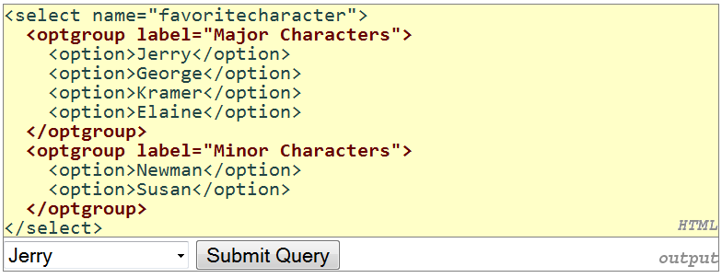
Drop-down List

Slide 17
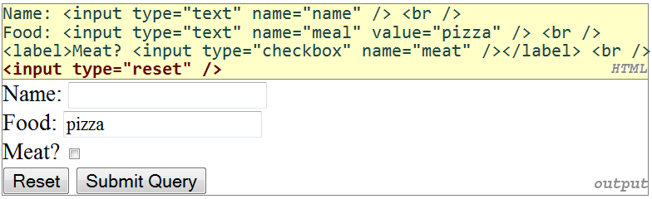
Reset Buttons

Slide 18
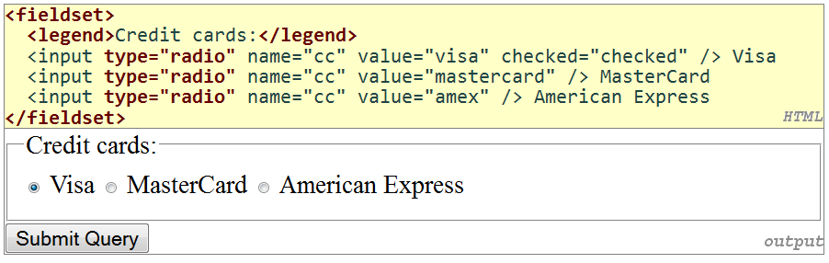
Grouping Controls

Slide 19
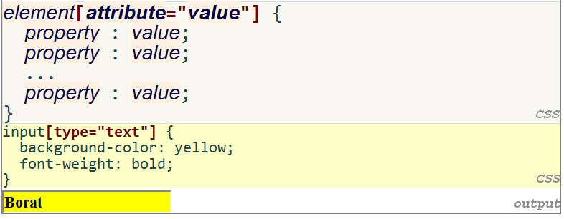
Styling Forms

Slide 20
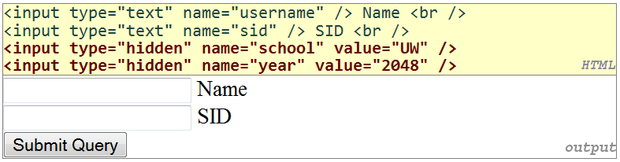
Hidden Input Parameters
Submit additional query parameter to a server without it being visible on the form’s UI
Notes:
an invisible parameter that is still passed to the server when form is submitted
useful for passing on additional state that isn't modified by the user

Slide 21
Common UI Control Errors
I changed the form's HTML code ... but when I refresh, the page doesn't update!
By default, when you refresh a page, it leaves the previous values in all form controls
it does this in case you were filling out a long form and needed to refresh/return to it
if you want it to clear out all UI controls' state and values, you must do a full refresh
Firefox: Shift-Ctrl-R
Mac: Shift-Command-R
Notes:
an invisible parameter that is still passed to the server when form is submitted
useful for passing on additional state that isn't modified by the user

Slide 22
Self-Check
Page 227

Slide 23
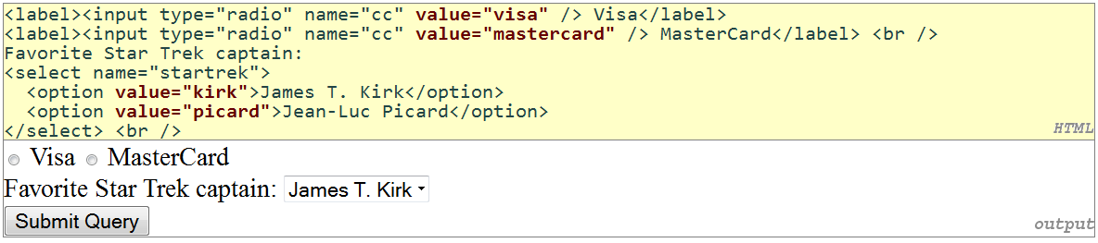
Submitting Data
Sometimes you want to submit data to a server
Hotmail: Send a message
Flickr: Upload a photo
Google Calendar: Create an appointment
the data is sent in HTTP requests to the server
with HTML forms
with Ajax (seen later)
the data is placed into the request as parameters
value attribute sets what will be submitted if a control is selected

Slide 24
URL Encoding
Certain characters are not allowed in URL query parameters:
examples: " ", "/", "=", "&“
When passing a parameter, it is URL-encoded (reference table)
"Marty's cool!?" → "Marty%27s+cool%3F%21“
You don't usually need to worry about this:
the browser automatically encodes parameters before sending them
the PHP $_REQUEST array automatically decodes them

Slide 25
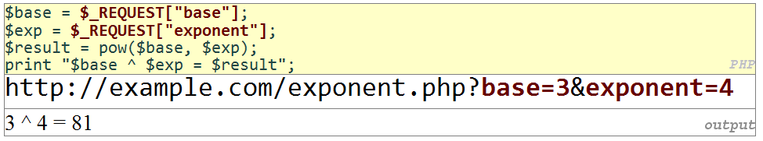
URL Encoding

Slide 26
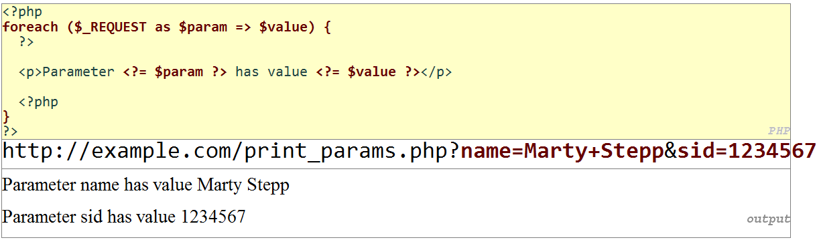
URL Encoding

Slide 27
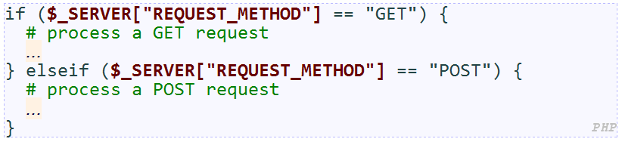
HTTP Requests: GET vs. POST
GET : asks a server for a page or data
if the request has parameters, they are sent in the URL as a query string
POST : submits data to a web server and retrieves the server's response
if the request has parameters, they are embedded in the request's HTTP packet, not the URL

Slide 28
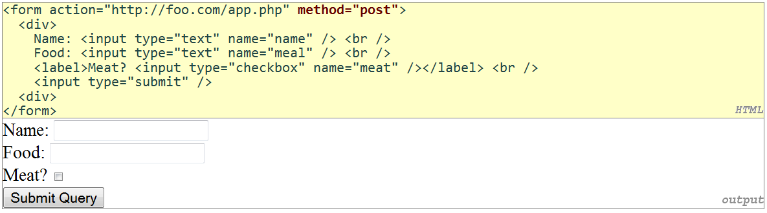
HTTP Requests: GET vs. POST
For submitting data, a POST request is more appropriate than a GET
GET requests embed their parameters in their URLs
URLs are limited in length (~ 1024 characters)
URLs cannot contain special characters without encoding
private data in a URL can be seen or modified by users

Slide 29
Self-Check
Page 232

Slide 30
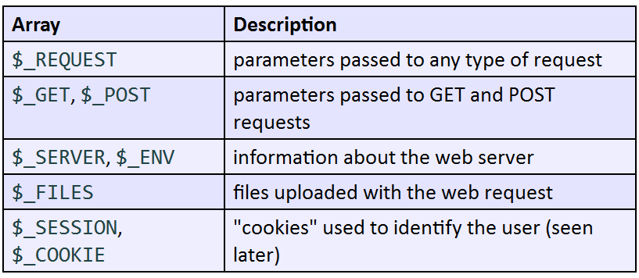
Processing Form Data in PHP
Superglobal Arrays

Slide 31
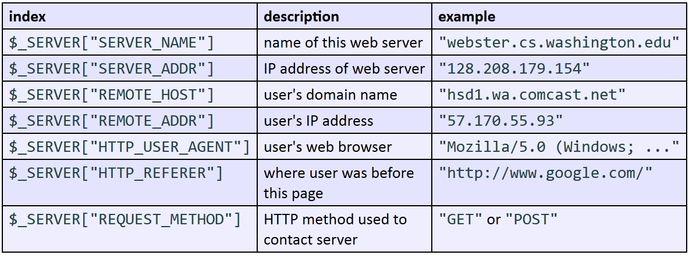
Processing Form Data in PHP
The $_SERVER Superglobal Arrays
Notes:
call phpinfo(); to see a complete list

Slide 32
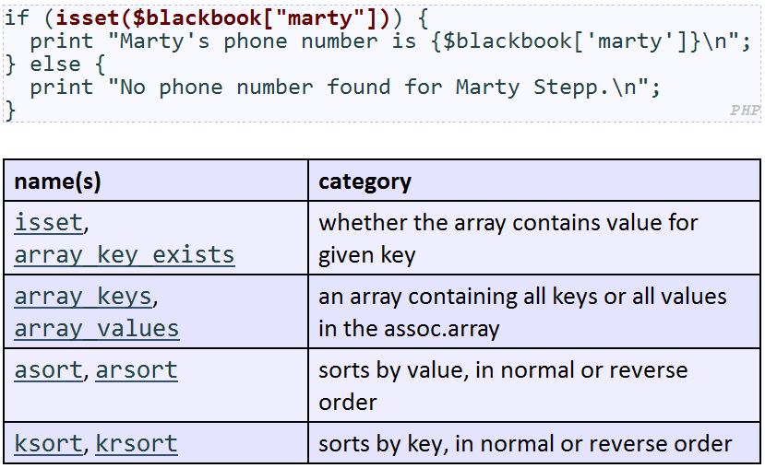
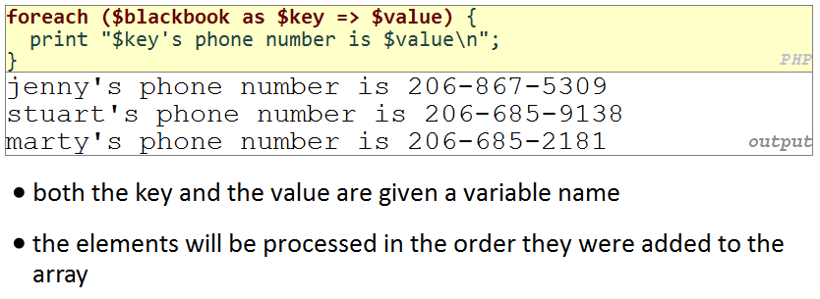
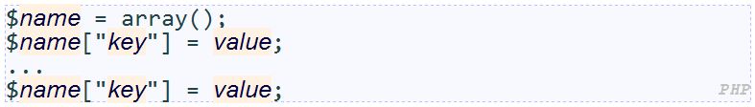
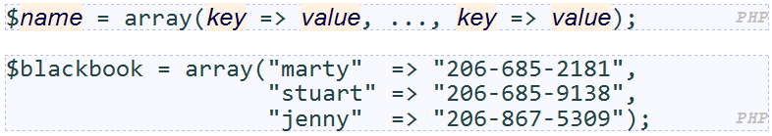
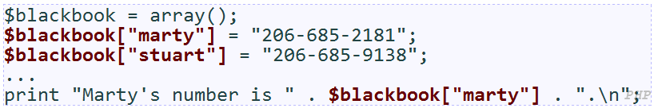
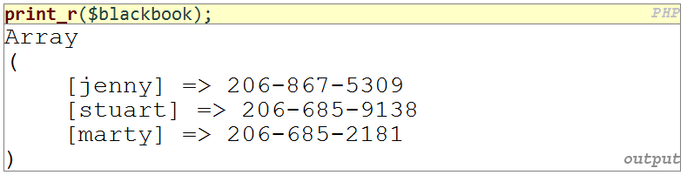
Processing Form Data in PHP
Associative Arrays

Slide 33
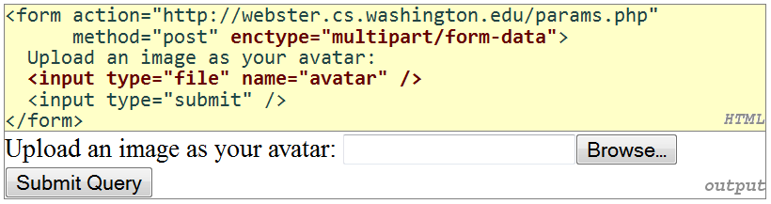
Processing Form Data in PHP
Uploading Files
Uploaded files are placed into global array $_FILES, not $_REQUEST
Each element of $_FILES is itself an associative array, containing:
name : the local filename that the user uploaded
type : the MIME type of data that was uploaded, such as image/jpeg
size : file's size in bytes
tmp_name : a filename where PHP has temporarily saved the uploaded file
to permanently store the file, move it from this location into some other file

Slide 34
Processing Form Data in PHP
Uploading Files
if you upload borat.jpg as a parameter named avatar,
$_FILES["avatar"]["name"] will be "borat.jpg"
$_FILES["avatar"]["type"] will be "image/jpeg"
$_FILES["avatar"]["tmp_name"] will be something like "/var/tmp/phpZtR4TI"

Slide 35
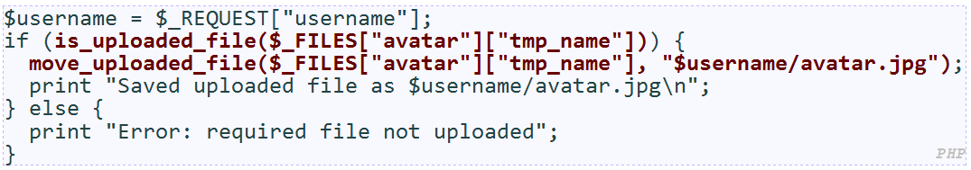
Processing Form Data in PHP
functions for dealing with uploaded files:
is_uploaded_file(filename) returns TRUE if the given filename was uploaded by the user
move_uploaded_file(from, to) moves from a temporary file location to a more permanent file
check is_uploaded_file, then do move_uploaded_file

Slide 36

Processing Form Data in PHP
Including files
inserts the entire contents of the given file into the PHP script's output page
encourages modularity
useful for defining reused functions needed by multiple pages

Slide 37
Processing Form Data in PHP
A Form that Submits to Itself
A form can submit its data back to itself by setting the action to the page's own URL (or blank)
Benefits
fewer pages/files (don't need a separate file for the code to process the form data)
can more easily re-display the form if there are any errors

Slide 38
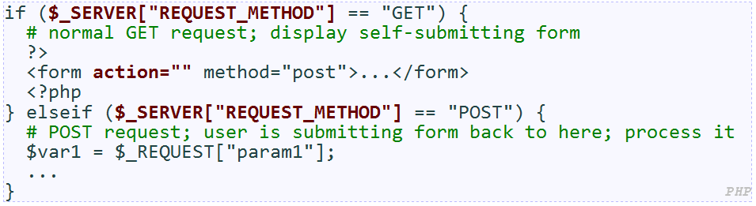
Processing Form Data in PHP
Processing a self-submitted form
a page with a self-submitting form can process both GET and POST requests
handle a GET by showing the form; handle a POST by processing the submitted form data

Slide 39
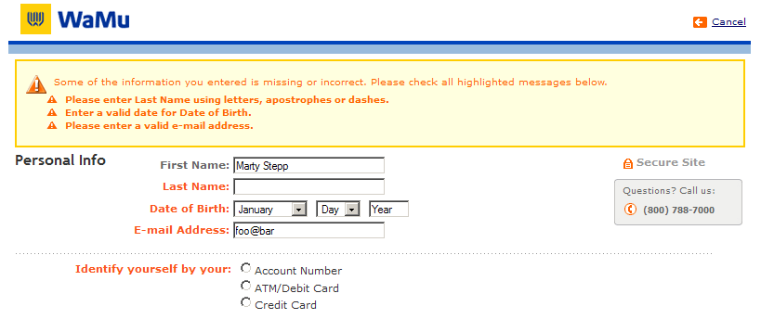
Processing Form Data in PHP
Form Validation
Ensuring that form's values are correct
Preventing blank values (email address)
Ensuring the type of values
Ensuring the format and range of values (ZIP code must be a 5-digit integer)
Ensuring that values fit together (user types email twice, and the two must match)

Slide 40
Processing Form Data in PHP
Client vs. server-side validation
client-side (before the form is submitted)
can lead to a better user experience, but not secure
server-side (in PHP code, after the form is submitted)
needed for truly secure validation, but slower
both
best mix of convenience and security, but requires most effort to program

Slide 41
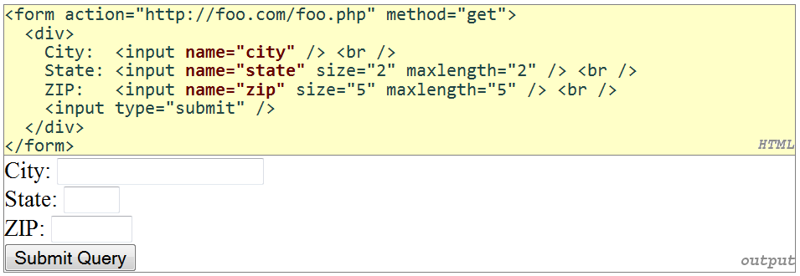
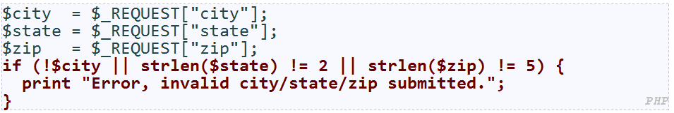
Processing Form Data in PHP
Basic server-side validation

Slide 42
Processing Form Data in PHP
Basic server-side validation
How do you test for integers vs. real numbers vs. strings?
How do you test for a valid credit card number?
How do you test that a person's name has a middle initial?

Slide 43
Regular Expressions (regex)
a description of a pattern of text
can test whether a string matches the expression's pattern
can use a regex to search/replace characters in a string
Is extremely powerful but tough to read
Occurs in many places:
Java: Scanner, String's split method
supported by PHP, JavaScript, and other languages
many text editors (TextPad) allow regexes in search/replace
Notes:
the above regular expression matches email addresses

Slide 44
Basic Regular Expressions
in PHP, regexes are strings that begin and end with /
/abc/ matches any string containing "abc":
YES: "abc", "abcdef", "defabc", ".=.abc.=.", ...
NO: "fedcba", "ab c", "PHP", ...
Notes:
the above regular expression matches email addresses

Slide 45
Regular Expressions (Wildcards)
A dot . matches any character except a \n line break
/.oo.y/ matches "Doocy", "goofy", "LooNy", ...
A trailing i at the end of a regex (after the closing /) signifies a case-insensitive match
/mart/i matches "Marty Stepp", "smart fellow", "WALMART", ...
Notes:
the above regular expression matches email addresses

Slide 46
Regular Expressions (Special)
| means OR
/abc|def|g/ matches "abc", "def", or "g"
There's no AND symbol. Why not?
() are for grouping
/(Homer|Marge) Simpson/ matches "Homer Simpson" or "Marge Simpson"
\ starts an escape sequence
many characters must be escaped to match them literally: / \ $ . [ ] ( ) ^ * + ?
/<br \/>/ matches lines containing <br /> tags
Notes:
the above regular expression matches email addresses

Slide 47
Regular Expressions (Quantifiers)
* means 0 or more occurrences
/abc*/ matches "ab", "abc", "abcc", "abccc", ...
/a(bc)*/ matches "a", "abc", "abcbc", "abcbcbc", ...
/a.*a/ matches "aa", "aba", "a8qa", "a!?xyz__9a", ...
+ means 1 or more occurrences
/a(bc)+/ matches "abc", "abcbc", "abcbcbc", ...
/Goo+gle/ matches "Google", "Gooogle", "Goooogle", ...
? means 0 or 1 occurrences
/a(bc)?/ matches "a" or "abc"
Notes:
the above regular expression matches email addresses

Slide 48
Regular Expressions (Quantifiers)
{min,max} means between min and max occurrences (inclusive)
/a(bc){2,4}/ matches "abcbc", "abcbcbc", or "abcbcbcbc“
min or max may be omitted to specify any number
{2,} means 2 or more
{,6} means up to 6
{3} means exactly 3
Notes:
the above regular expression matches email addresses

Slide 49
Regular Expressions (Anchors)
^ represents the beginning of the string or line; $ represents the end
/Jess/ matches all strings that contain Jess; /^Jess/ matches all strings that start with Jess; /Jess$/ matches all strings that end with Jess; /^Jess$/ matches the exact string "Jess" only
/^Mart.*Stepp$/ matches "MartStepp", "Marty Stepp", "Martin D Stepp", ... but NOT "Marty Stepp stinks" or "I H8 Martin Stepp“
Notes:
the above regular expression matches email addresses

Slide 50
Regular Expressions (Character Sets)
[] group characters into a character set; will match any single character from the set
/[bcd]art/ matches strings containing "bart", "cart", and "dart"
equivalent to /(b|c|d)art/ but shorter
inside [], many of the modifier keys act as normal characters
/what[!*?]*/ matches "what", "what!", "what?**!", "what??!", ...
Notes:
the above regular expression matches email addresses

Slide 51
Regular Expressions (Character Ranges)
inside a character set, specify a range of characters with –
/[a-z]/ matches any lowercase letter
/[a-zA-Z0-9]/ matches any lower- or uppercase letter or digit
an initial ^ inside a character set negates it
/[^abcd]/ matches any character other than a, b, c, or d
inside a character set, - must be escaped to be matched
/[+\-]?[0-9]+/ matches an optional + or -, followed by at least one digit
What regular expression matches letter grades such as A, B+, or D- ?
/[ABCDF][+\-]?/
Notes:
the above regular expression matches email addresses

Slide 52
Regular Expressions (Escape Sequences)
Special escape sequence character sets:
\d matches any digit (same as [0-9]); \D any non-digit ([^0-9])
\w matches any word character (same as [a-zA-Z_0-9]); \W any non-word char
\s matches any whitespace character ( , \t, \n, etc.); \S any non-whitespace
What regular expression matches dollar amounts of at least $100.00 ?
Notes:
the above regular expression matches email addresses

Slide 53
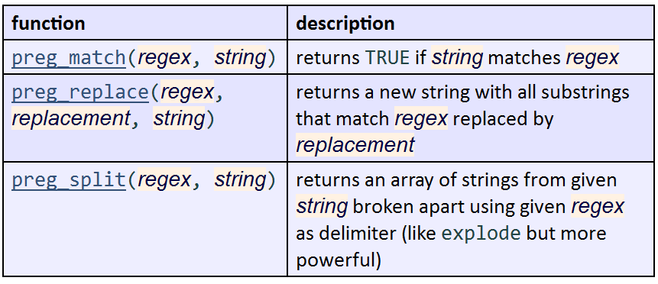
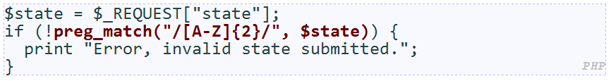
Regular Expressions in PHP (PDF)

Slide 54
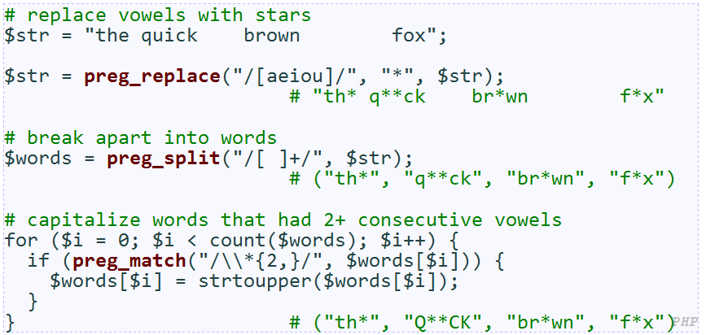
Regular Expressions in PHP (PDF)
Notes:
notice how \ must be escaped to \\

Slide 55
Self-Check
Page 241
Reading Assignments:
Ch 6.5 Case Study: Vocab Quiz
http://www.pacificescience.com/jgao/COMP127/code/ch06-forms/quiz.php

Slide 56
Summary
Form controls
Submitting data
Processing form data in PHP

